Slide 1

Introduction to Operating Systems CS/COE 1550
Spring 2020-2021
Sherif Khattab
ksm73@pitt.edu
(Some slides are from Silberschatz, Galvin and Gagne ©2013)

Slide 2
Announcements
Upcoming deadlines:
3/12: Homework 7
3/15: Project 2 (Extended Deadline)
Tophat questions due one week after each lecture
Comment on each other’s muddiest points
Women in Data Science Conference
http://www.stat.cmu.edu/wids/
Mathematics Colloquium this Friday at 3:30 pm
http://mathematics.pitt.edu/events/alumni-colloquium-career-having-your-cake-and-eating-it-too
The Student Experience in the Research University (SERU) survey
https://www.pittwire.pitt.edu/announcements/undergraduate-students-pittsburgh-campus-take-2021-seru-survey

Slide 3
Last Lecture …
CPU Scheduling Algorithms
Multi-level Feedback
Estimating CPU burst time
Memory Management

Slide 4
Muddiest Points (1/2)
CPU Burst Estimation
Exponential averaging along with how to find the variables associated with it.
does alpha only uses those values or it depends
How do the alpha values help us predict cpu burst times?
I'm still a little shaky on how the different alpha values can allow us to differently predict CPU burst times (0.8 vs 0.5 vs 0.2)
Exponential Alpha and how it relates to CPU bursting/overall Scheduling performance metrics.
I did not understand what the graph meant for exponentially decreasing coefficients.
Should we know how to calculate CPU burst?
In multilevel feedback scheduling, what exactly determines if a process should move down or up a queue?
Tracing multilevel queues
How to determine the priority of queue in the multi-level feedback algorithm? Is it based on the scheduling algorithm taken in that queue?
Also could we have better depictions of the mathematical algorithms? (Like written in Latex/more formal math notation instead of text in the slides)
In shortest job first, if a process is preempted after its quantum expires at the same time a new process arrives, which one is added to the queue first?
cpu-bound vs i/o-bound: how that affects scheduling

Slide 5
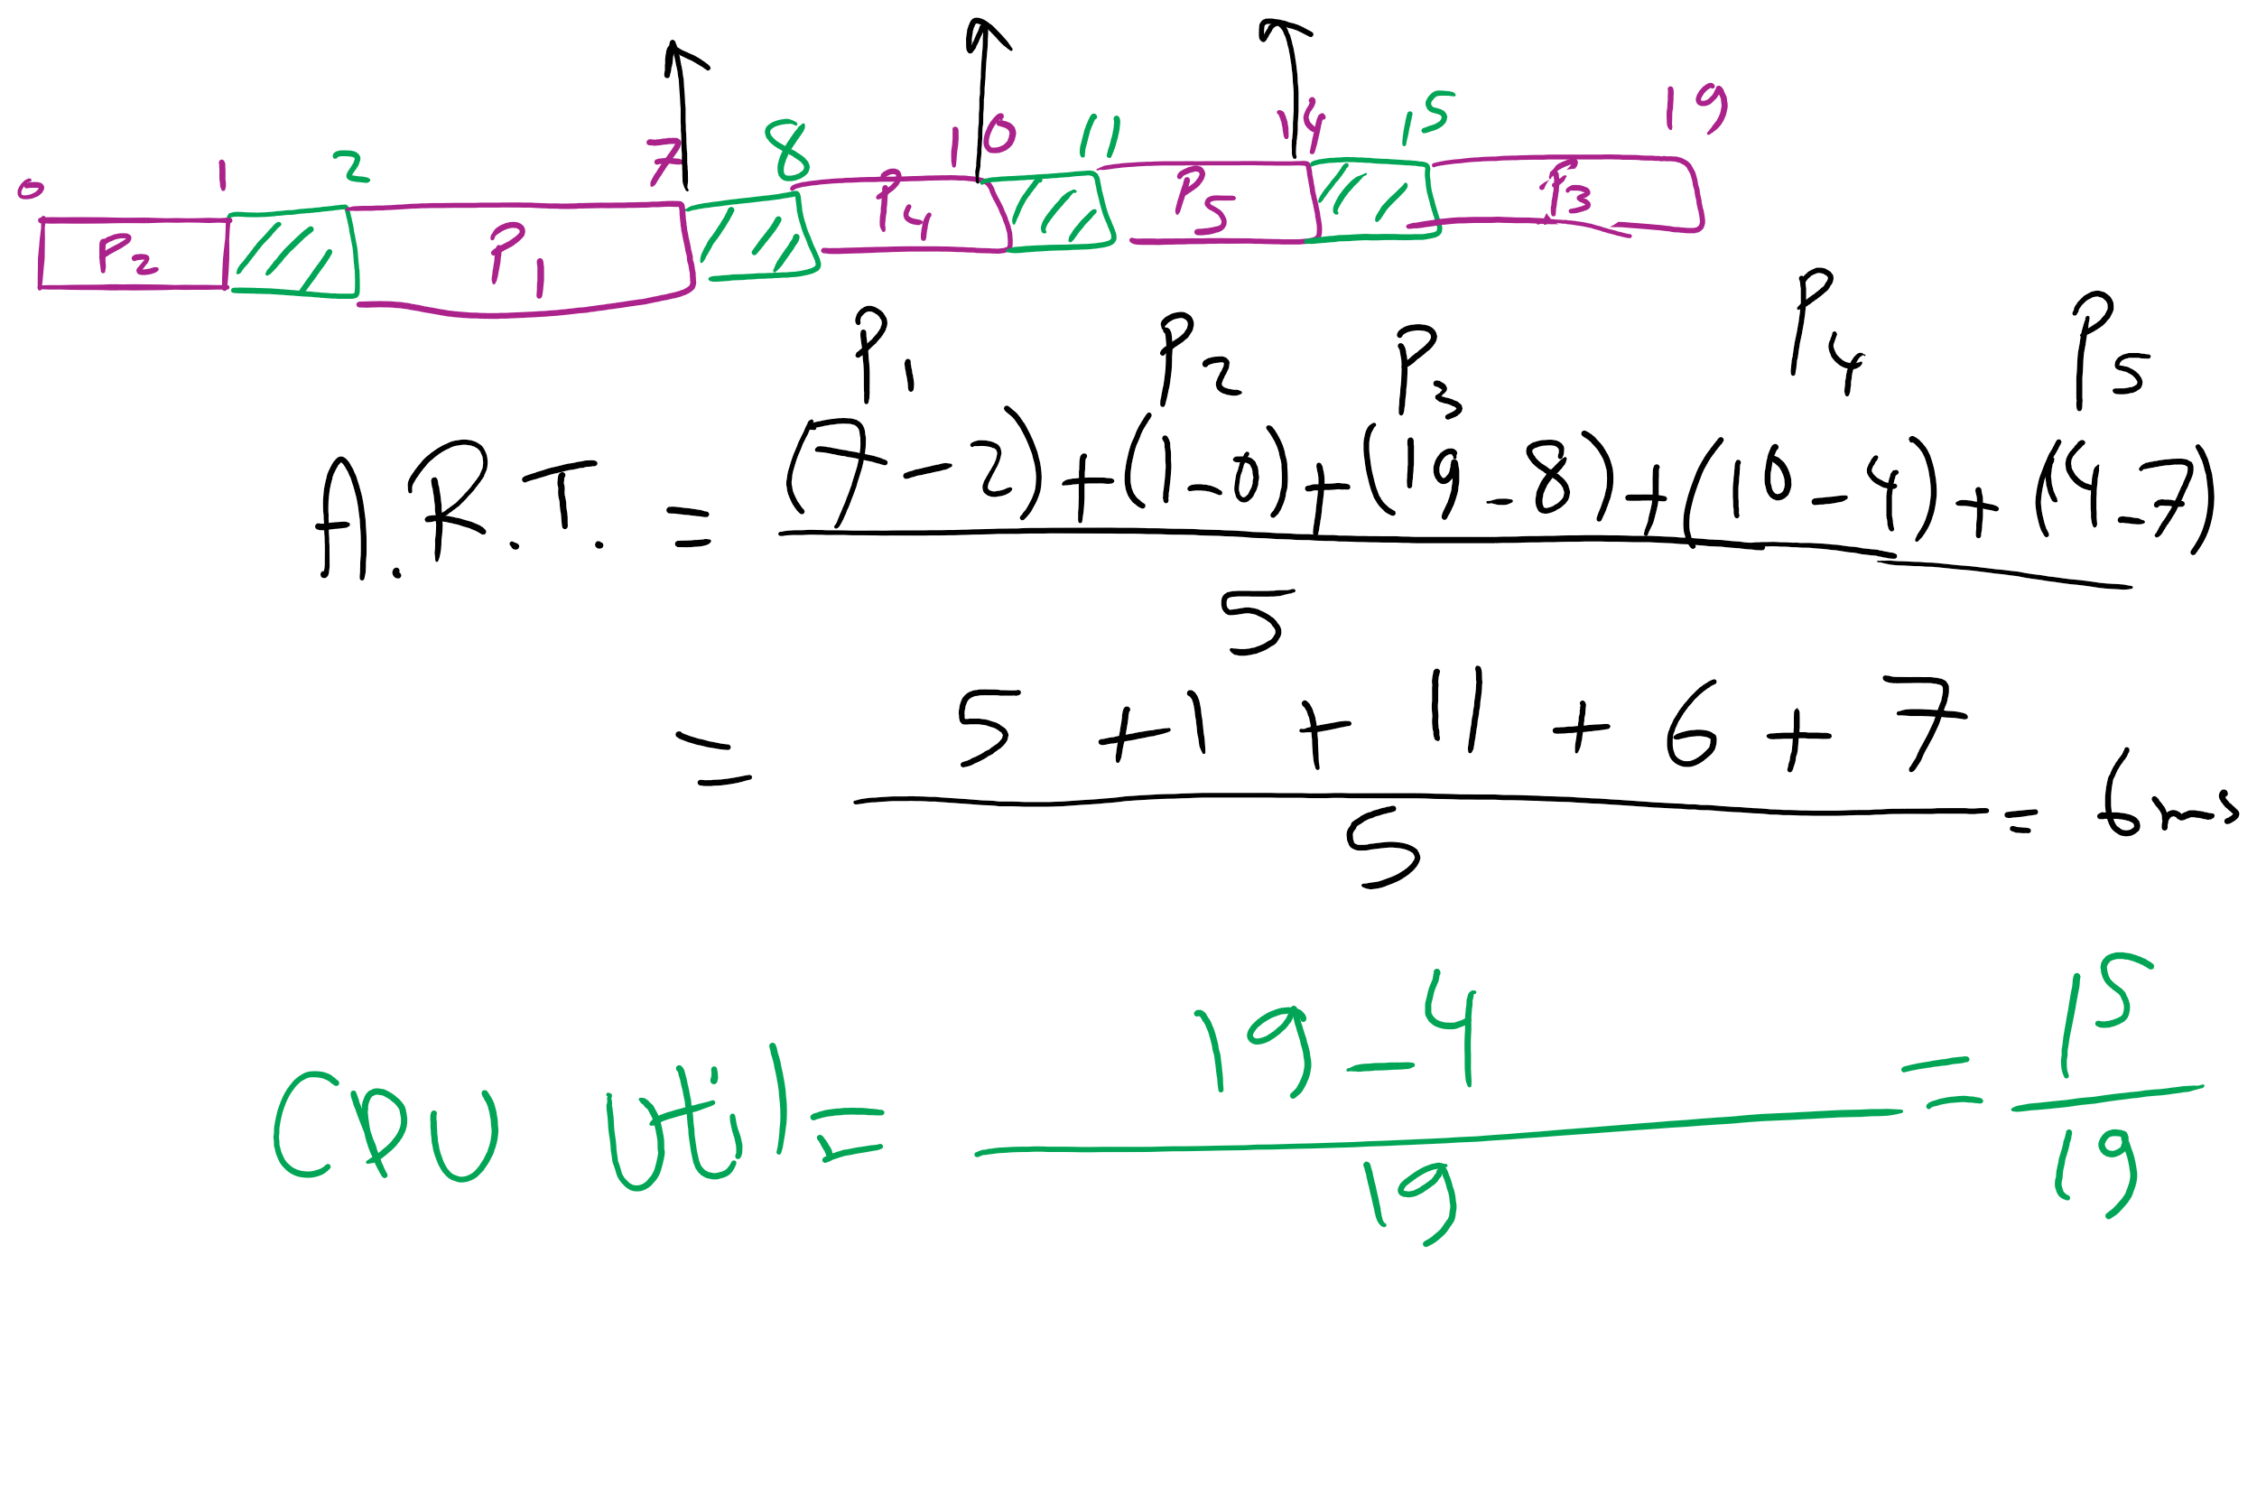
FCFS Problem in HW7

Slide 6
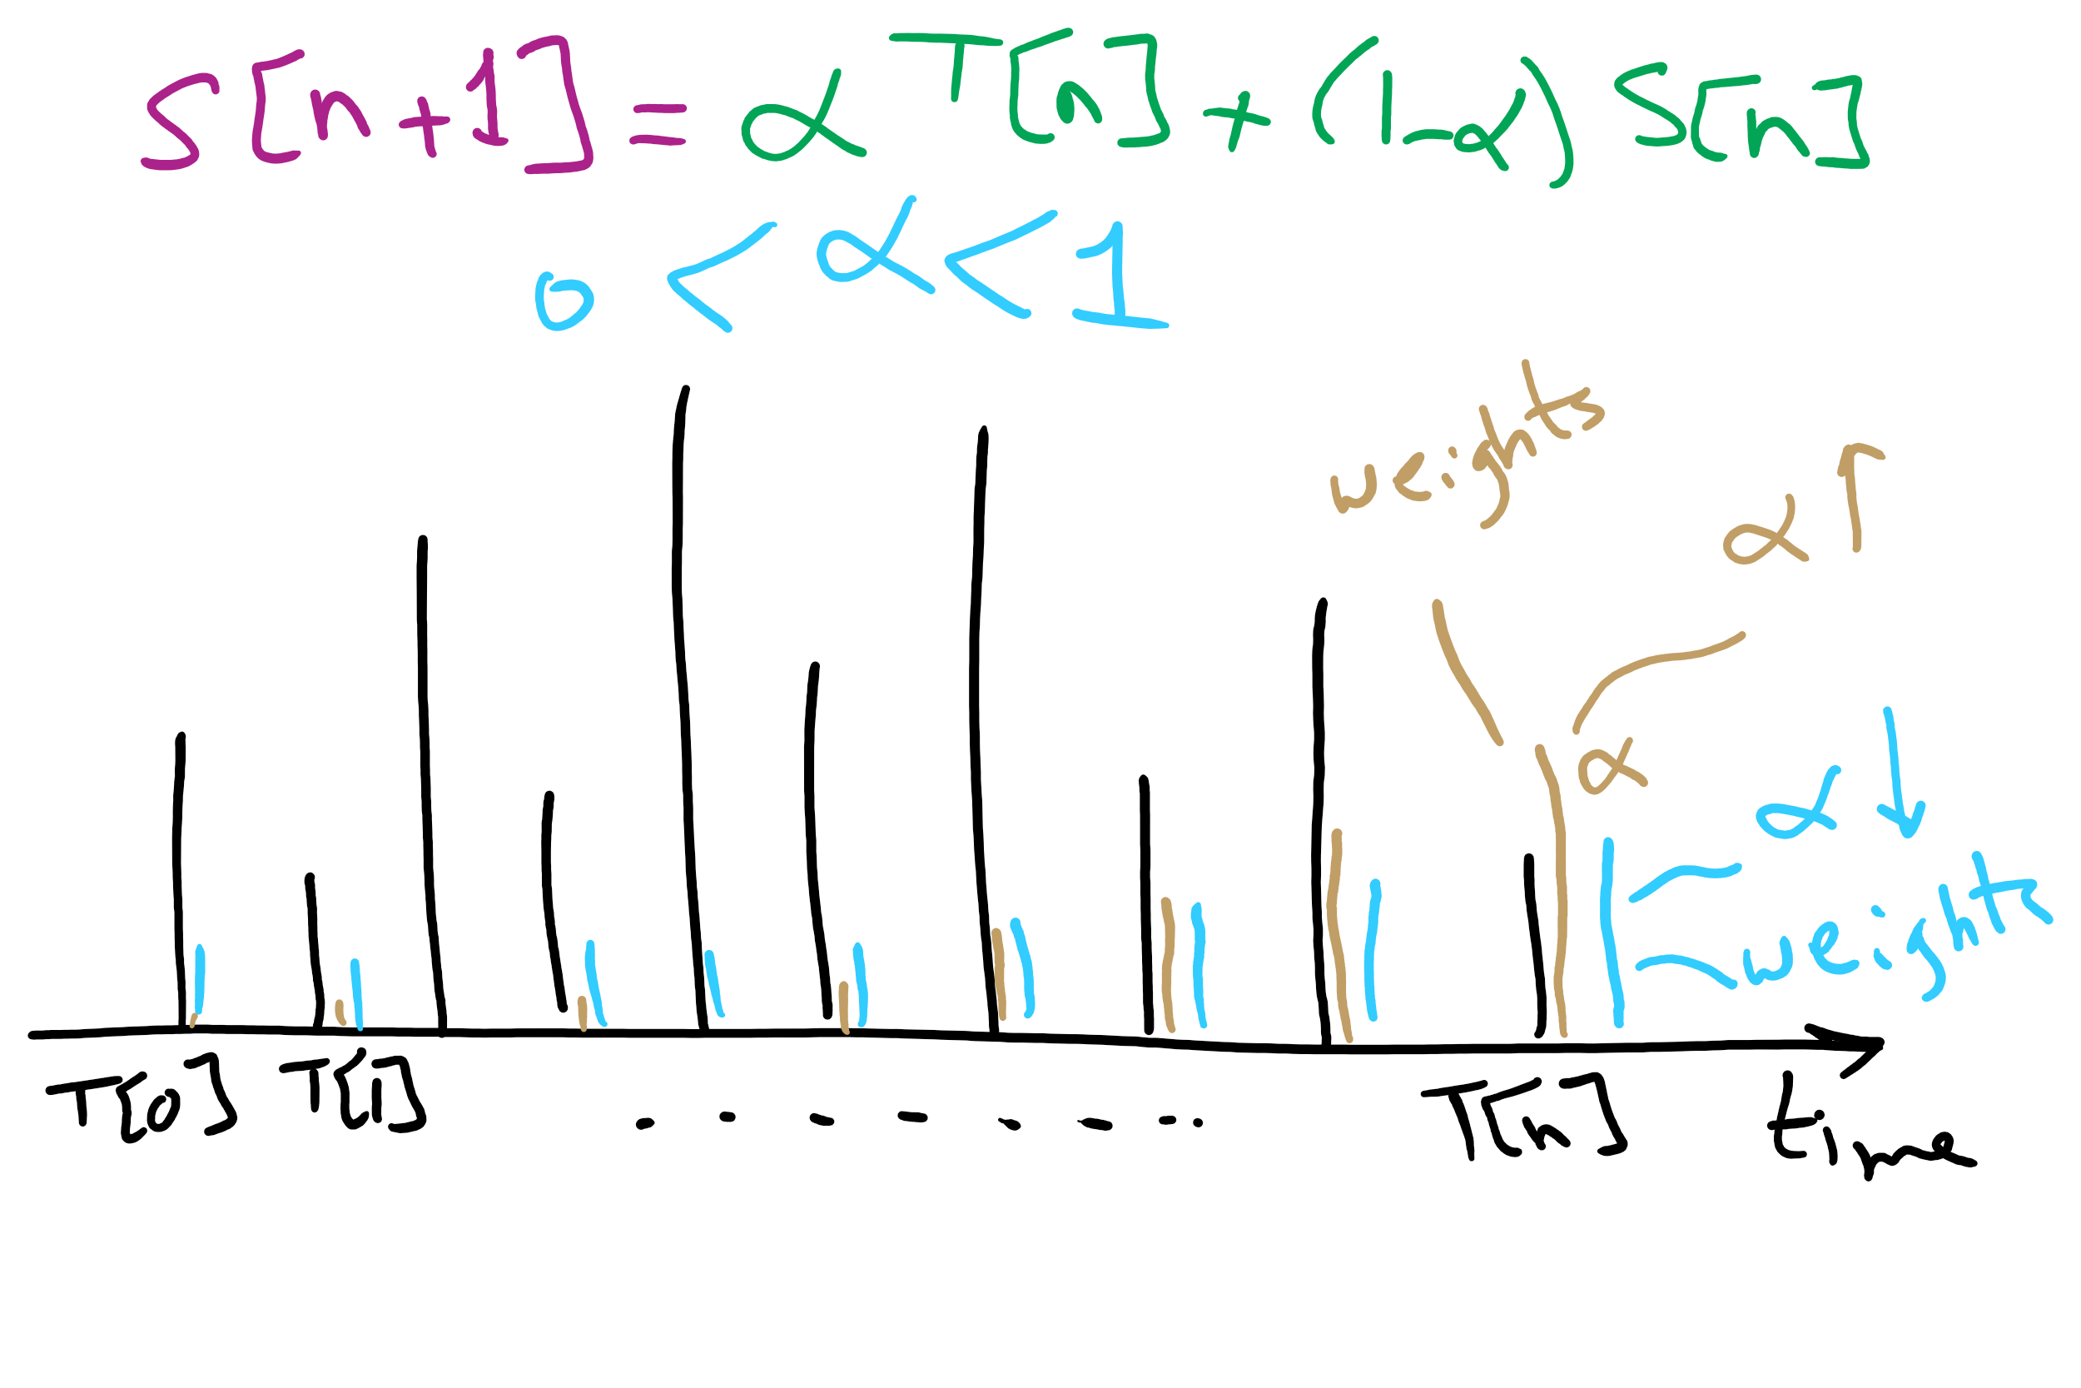
CPU Burst Estimation

Slide 7
Muddiest Points (2/2)
Memory Management
the whole memory management section was confusing.
The 3 basic memory organization methods (particularly the rightmost one that used device drivers)
How to choose a partition scheme (example scenario)
While assigning memory to the processes, how does it know the memory each process is going to need before it runs?
What does no swapping or paging mean?
base and limit registers
Some elaboration on how memory management protection "may not" be an issue if there is only process running? What are the risks with multiple processes?
How are new processes set up in a fixed partition scheme with a global input queue?
how different queues for partitions affect CPU usage
dynamic partitioning and how you select processes to enter memory
The cpu usage graph and i/o vs cpu utilization

Slide 8
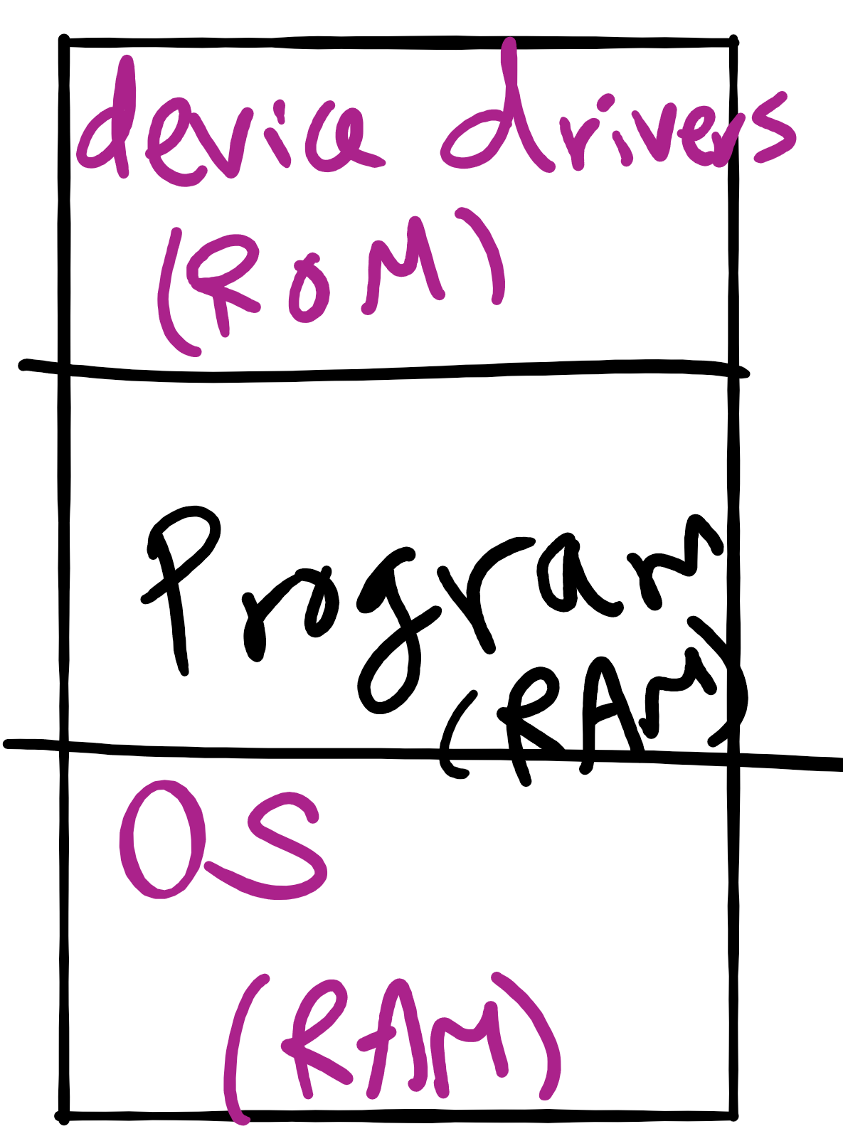
Memory Management for Embedded Systems

Slide 9
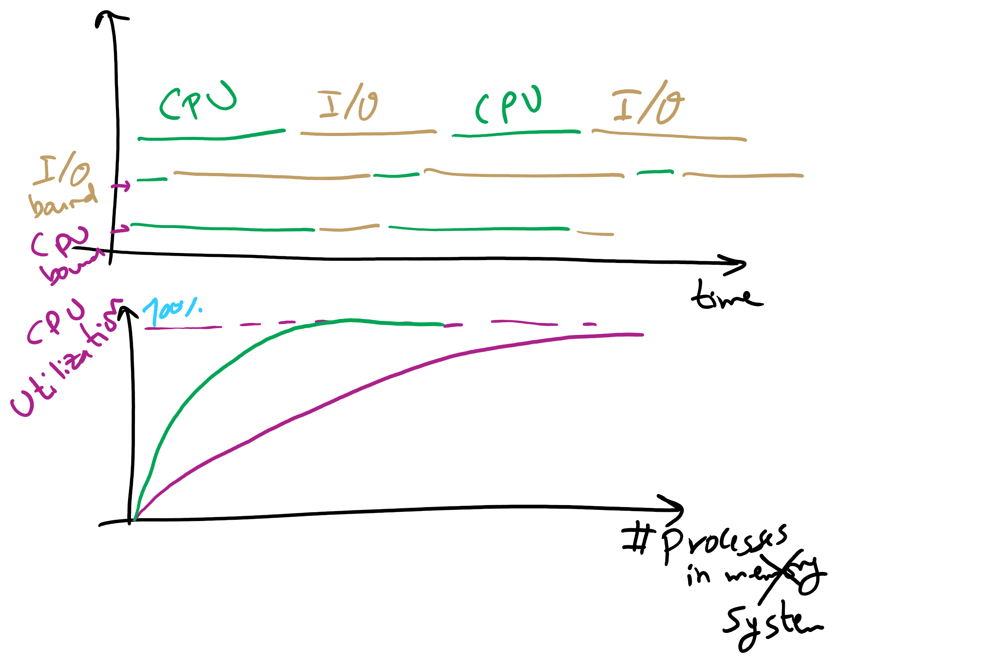
Why do we need more processes?

Slide 10
Today’s Agenda …
Virtual Memory
Page Replacement Algorithms

Slide 11
Base and limit registers
Special CPU registers: base & limit
Access to the registers limited to kernel (privileged) mode
Registers contain
Base: start of the process’s memory partition
Limit: length of the process’s memory partition
Address generation
Physical address: location in actual memory
Logical address: location from the process’s point of view
Physical address = base + logical address
Logical address larger than limit => error
0xFFFF
0x2000
Limit
Process partition
Base
0x9000
OS
0
Logical address: 0x1204 Physical address: 0x1204+0x9000 = 0xa204

Slide 12
Virtual memory
Basic idea: allow the OS to hand out more memory than exists on the system
Keep recently used stuff in physical memory
Move less recently used stuff to disk
Keep all of this hidden from processes
Processes still see an address space from 0 – max address
Movement of information to and from disk handled by the OS without process help
Virtual memory (VM) especially helpful in multiprogrammed system
CPU schedules process B while process A waits for its memory to be retrieved from disk

Slide 13
Virtual and physical addresses
Program uses virtual addresses
Addresses local to the process
Hardware translates virtual address to physical address
Translation done by the Memory Management Unit
Usually on the same chip as the CPU
Only physical addresses leave the CPU/MMU chip
Physical memory indexed by physical addresses
CPU chip
CPU
MMU
Virtual addresses from CPU to MMU
Memory
Physical addresses on bus, in memory
Disk controller

Slide 14
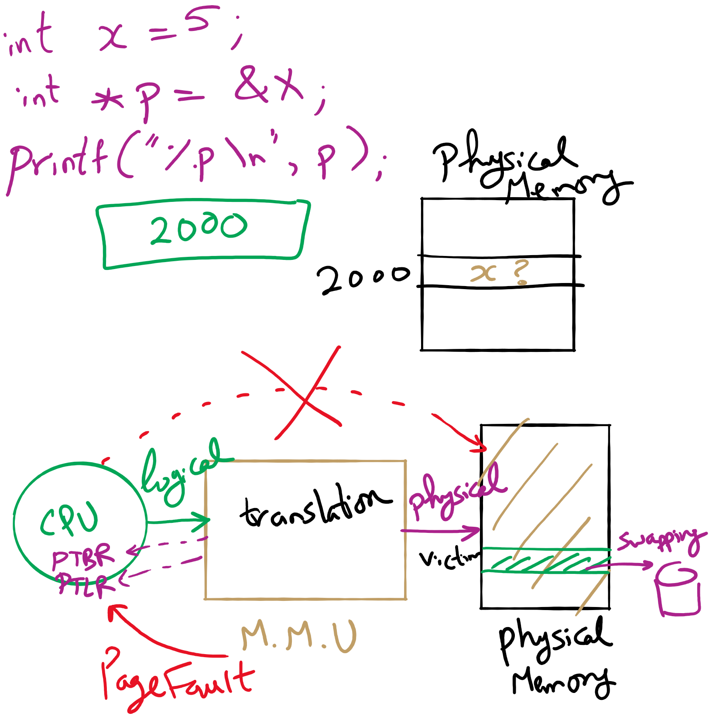
Address Translation

Slide 15
Paging and page tables
Virtual addresses mapped to physical addresses
Unit of mapping is called a page
All addresses in the same virtual page are in the same physical page
Page table entry (PTE) contains translation for a single page
Table translates virtual page number to physical page number
Not all virtual memory has a physical page
Not every physical page need be used
Example:
64 KB virtual memory
32 KB physical memory
60–64K
-
56–60K
-
52–56K
-
48–52K
6
44–48K
5
40–44K
1
36–40K
-
32–36K
-
28–32K
3
28–32K
24–28K
-
24–28K
20–24K
-
20–24K
16–20K
0
16–20K
12–16K
-
12–16K
8–12K
-
8–12K
4–8K
4
4–8K
0–4K
7
0–4K
Virtual address space
Physical memory

Slide 16
What’s in a page table entry?
Each entry in the page table contains
Valid bit: set if this logical page number has a corresponding physical frame in memory
If not valid, remainder of PTE is irrelevant
Page frame number: page in physical memory
Referenced bit: set if data on the page has been accessed
Dirty (modified) bit :set if data on the page has been modified
Protection information
Protection
D
R
V
Page frame number
Dirty bit
Referenced bit
Valid bit

Slide 17
Implementing page tables in hardware
Page table resides in main (physical) memory
CPU uses special registers for paging
Page table base register (PTBR) points to the page table
Page table length register (PTLR) contains length of page table: restricts maximum legal logical address
Translating an address requires two memory accesses
First access reads page table entry (PTE)
Second access reads the data / instruction from memory
Reduce number of memory accesses
Can’t avoid second access (we need the value from memory)
Eliminate first access by keeping a hardware cache (called a translation lookaside buffer or TLB) of recently used page table entries

Slide 18
Page replacement algorithms
Page fault forces a choice
No room for new page (steady state)
Which page must be removed to make room for an incoming page?
How is a page removed from physical memory?
If the page is unmodified, simply overwrite it: a copy already exists on disk
If the page has been modified, it must be written back to disk: prefer unmodified pages?
Better not to choose an often used page
It’ll probably need to be brought back in soon

Slide 19
Optimal page replacement algorithm
What’s the best we can possibly do?
Assume perfect knowledge of the future
Not realizable in practice (usually)
Useful for comparison: if another algorithm is within 5% of optimal, not much more can be done…
Algorithm: replace the page that will be used furthest in the future
Only works if we know the whole sequence!
Can be approximated by running the program twice
Once to generate the reference trace
Once (or more) to apply the optimal algorithm
Nice, but not achievable in real systems!

Slide 20
Not-recently-used (NRU) algorithm
Each page has reference bit and dirty bit
Bits are set when page is referenced and/or modified
Pages are classified into four classes
0: not referenced, not dirty
1: not referenced, dirty
2: referenced, not dirty
3: referenced, dirty
Clear reference bit for all pages periodically
Can’t clear dirty bit: needed to indicate which pages need to be flushed to disk
Class 1 contains dirty pages where reference bit has been cleared
Algorithm: remove a page from the lowest non-empty class
Select a page at random from that class
Easy to understand and implement
Performance adequate (though not optimal)

Slide 21
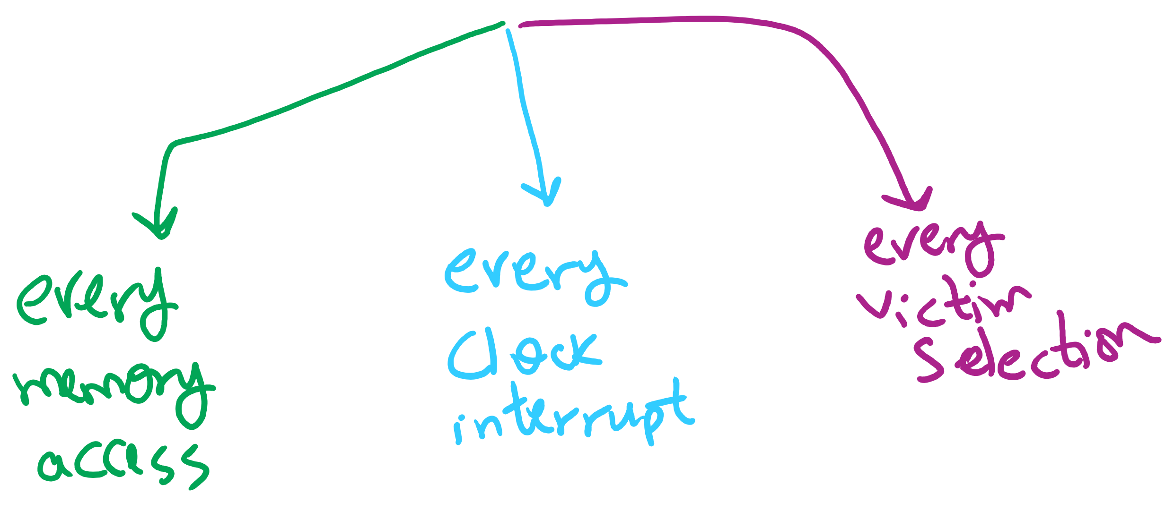
Page Replacement Algorithms Components

Slide 22
First-In, First-Out (FIFO) algorithm
Maintain a linked list of all pages
Maintain the order in which they entered memory
Page at front of list replaced
Advantage: (really) easy to implement
Disadvantage: page in memory the longest may be often used
This algorithm forces pages out regardless of usage
Usage may be helpful in determining which pages to keep

